Slide 1
BANK Customer segmentation
A Clustering Model To Identify Distinct Customer Groups For Marketing Strategies.
Peerapat.t
For project’s material please visit : github.com/peerapat-t

Slide 2

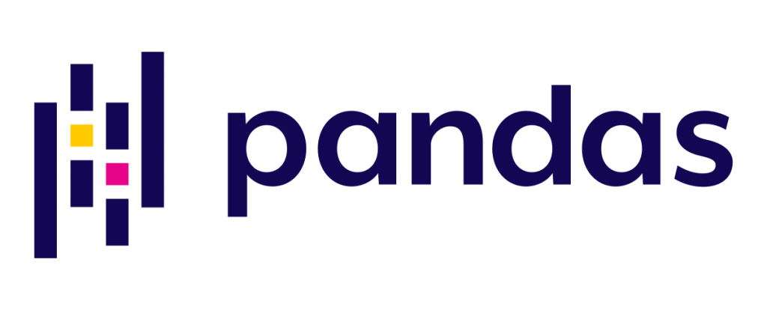
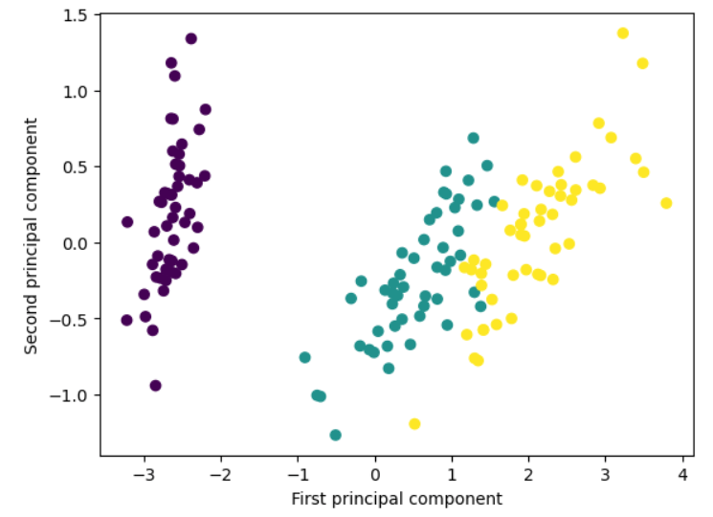
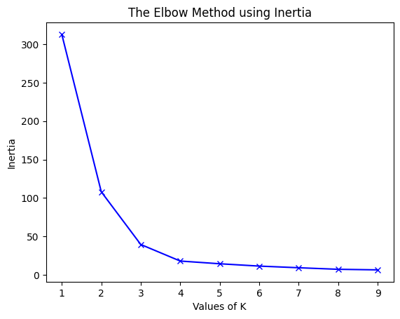
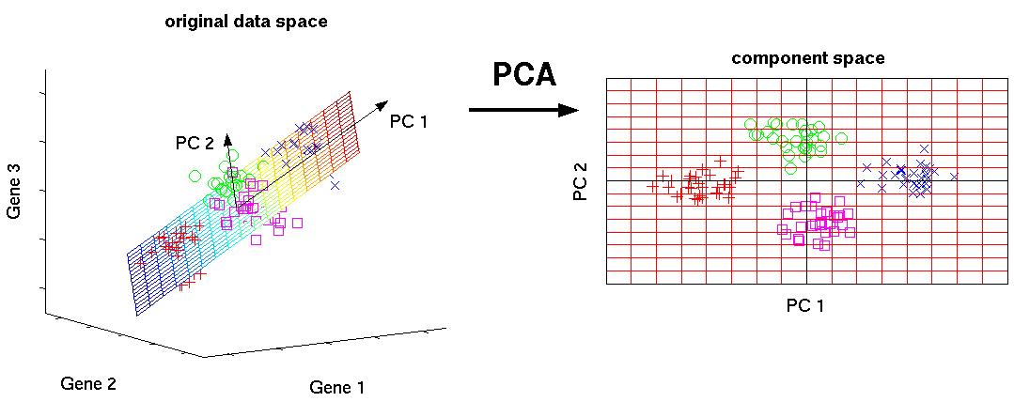

BANK Customer segmentation
Problem context
In the ever-changing world of banking, personalized services capture customer attention, foster loyalty, and increase conversion rates.
Additionally, they optimize resource allocation and provide valuable insights for informed decision-making and service enhancement.
Challenges
Feature engineering
Interpret the segment
Tools
Methods
Business impact
Customer segmentation can significantly impact business by allowing targeted marketing efforts, tailored products/services, and improved customer satisfaction.
KMeans
Elbow method
PCA
BANK CUSTOMERS SEGMENTATION

Slide 3
Table of content
Problem Statement
Business Value
Methodology
Results
Conclusions/Recommendations
Future Work
Appendix
About me
BANK CUSTOMERS SEGMENTATION

Slide 4
1. PROBLEM STATEMENT
In the competitive banking industry, the challenge is to implement effective personalized services by:
  Increasing Engagement: Deliver tailored solutions to capture customer attention.
  Building Loyalty: Create personalized experiences to foster enduring relationships.
  Boosting Conversions: Offer customized services to turn prospects into customers.
  Efficient Resource Allocation: Target resources where they'll yield the best results.
  Gaining Insights: Use data analysis to understand customer behavior for informed decision-making and product refinement.
BANK CUSTOMERS SEGMENTATION

Slide 5
2. BUSINESS VALUE
Implementing personalized banking services can provide significant business value, including:
  Enhanced Engagement: Tailored services boost customer satisfaction and loyalty.
  Improved Retention: Personalization reduces churn rates and extends customer lifetime value.
  Increased Revenue: Customization drives customer acquisition and cross-selling success.
  Efficient Resources: Targeted strategies optimize resource allocation, reducing waste.
  Informed Decisions: Data-driven insights inform product development and marketing, enhancing competitiveness.
BANK CUSTOMERS SEGMENTATION

Slide 6
3. METHODOLOGY
Condition-Based Segmentation
Advantages:
  Clear and interpretable criteria.
  Customization to specific business needs.
  Easily aligned with predefined goals.
Disadvantages:
  Rigid and may not adapt to changing behaviors.
  Oversimplifies customer behavior.
  May miss unexpected insights from data.
Clustering Models
Advantages:
  Unbiased and data-driven segmentation.
  Automation and scalability.
  Flexibility for changing data patterns.
  Discovery of hidden customer patterns.
Disadvantages:
  Less interpretable cluster labels.
  Sensitivity to initial conditions.
  Subjective choice of features.
BANK CUSTOMERS SEGMENTATION

Slide 7
3. METHODOLOGY
Features
This dataset comprises over 1 million transactions involving more than 800,000 customers of an Indian bank. The dataset encompasses various details including:
  Customer age
  Location
  Gender
  Average transaction time
  Average account balance amount
  Average transaction amount
  Number of transaction
RFM
BANK CUSTOMERS SEGMENTATION

Slide 8

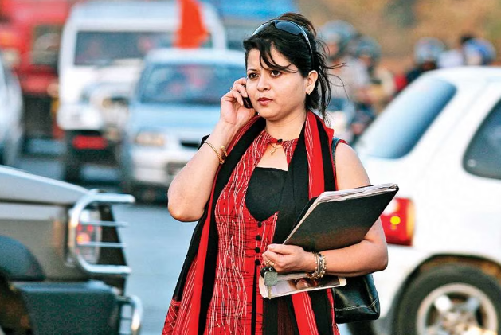


4. RESULT
Customer segment
Following the model's results, we have 4 groups of customers.
1. Urban man
(30.95% of customers)
2. Urban woman
(9.56% of customers)
3. Suburban man
(45.38% of customers)
4. Suburban woman
(14.11% of customers)
Reside in large cities
Male
Oldest
Highest account balance
Most frequent transactions
Reside in large cities
Female
Largest average transaction amount
Reside in suburban areas
Male
Higher account balance compared to suburban women
More frequent transactions than suburban women
Reside in suburban areas
Female
Youngest age
Larger average transaction amount compared to suburban men
BANK CUSTOMERS SEGMENTATION

Slide 9
4. RESULT
Customer segment
1. Urban man
Assume that men use bank transactions for daily expenses (smaller transaction amounts but higher frequency), we should consider collaborating with urban-zone shops, such as coffee shops, to provide promotions through bank transactions. Given the affluence of this group, we can also recommend financial asset opportunities.
2. Urban woman
Assume that women use bank transactions for purchases like fashion clothing or cosmetics (less frequent but larger amounts), we should explore collaboration with fashion and cosmetic shops in urban zones to offer promotions through bank transactions.
BANK CUSTOMERS SEGMENTATION

Slide 10
4. RESULT
Customer segment
3. Suburban man
Assume that men use bank transactions for daily expenses (smaller transaction amounts but higher frequency), a collaboration strategy could involve suburban-zone shops, such as coffee shops, to provide promotional offers using bank transactions.
4. Suburban woman
Assume that women use bank transactions for purchases like fashion clothing or cosmetics (less frequent but larger amounts), collaborating with fashion and cosmetic shops in suburban zones to provide promotions through bank transactions could be effective.
BANK CUSTOMERS SEGMENTATION

Slide 11
5. Conclusions/Recommendations
Conclusions
Based on the results from the model, we have identified four distinct customer groups: urban men, urban women, suburban men, and suburban women. These groups exhibit differences in various attributes, including their account balances and transaction frequencies.
Recommendation
Leveraging these insights, we can develop personalized marketing strategies aimed at enhancing customer relationships and boosting the company's revenue.
BANK CUSTOMERS SEGMENTATION

Slide 12
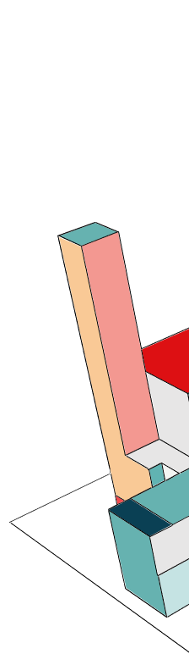
6. Future work
Try another algorithm, such as DBSCAN or hierarchical clustering, and compare the results of them.
Create new features to better understand customer behavior. However, this will require re-clustering.
Monitor the distribution of new data; if the distribution changes significantly, re-clustering should be considered
BANK CUSTOMERS SEGMENTATION

Slide 13
End of PRESENTATION
13
BANK CUSTOMERS SEGMENTATION

Slide 14
7. Appendix
Technique
Step | Topic | Method
1 | Normalization | Use Min-Max scaling to normalize the data.
2 | Clustering | Implement K-Means clustering to group similar data points.
3 | Selecting K | Determine the optimal number of clusters using the elbow method. Analyze attribute means to select a meaningful value for K in the context of marketing segmentation.
4 | Visualization | Utilize PCA to visualize the clustered data.
BANK CUSTOMERS SEGMENTATION

Slide 15
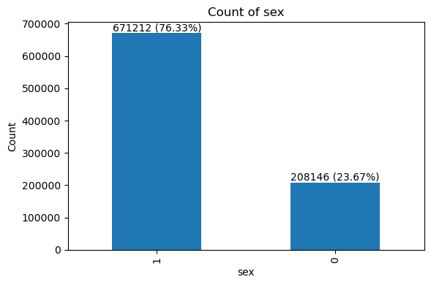
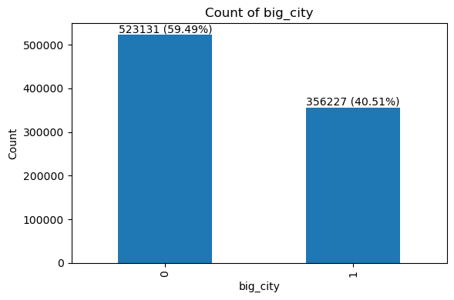
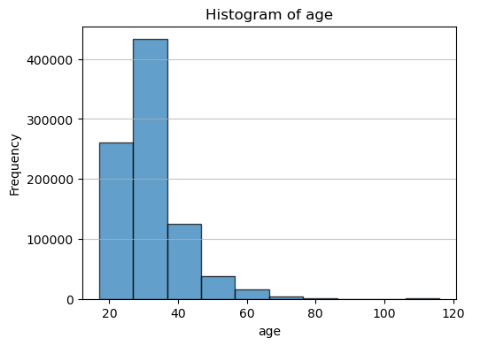
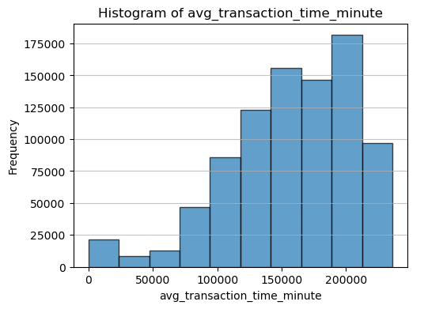
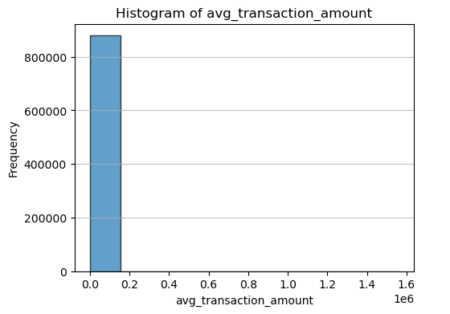
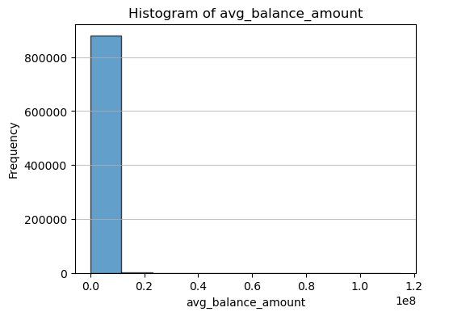
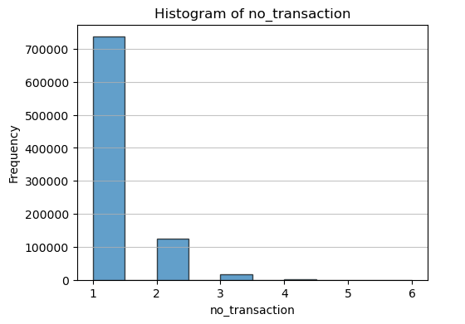
7. Appendix
Exploratory data analysis (EDA)
Both attributes appear significantly different, making them important features for distinguishing each cluster. 76% of customers are men, and 59% of customers live in big cities.
However, transaction amounts and balance amounts are quite similar among customers.
BANK CUSTOMERS SEGMENTATION

Slide 16
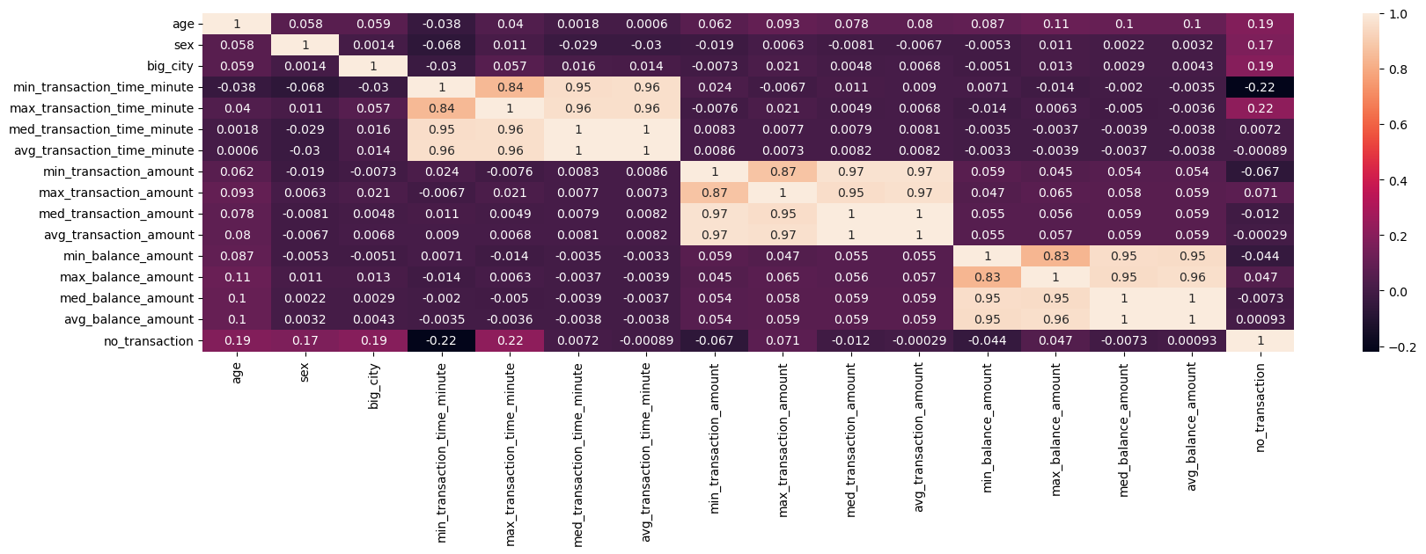
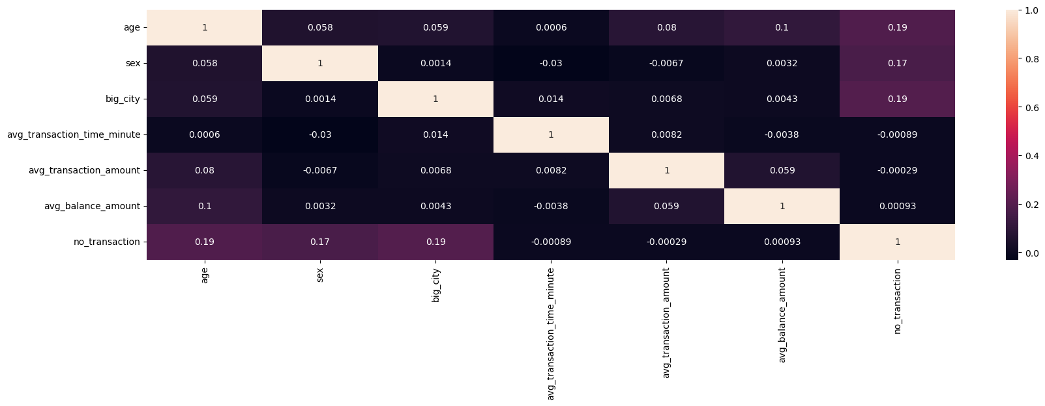
7. Appendix
Exploratory data analysis (EDA)
We create Max, Min, Med, and Avg for each feature, but they have a high correlation among them, so I'm decide to drop it.
BANK CUSTOMERS SEGMENTATION

Slide 17
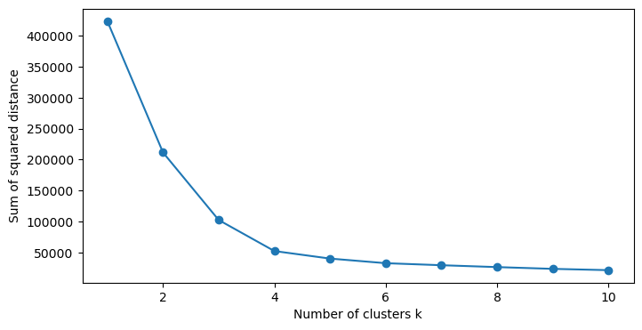
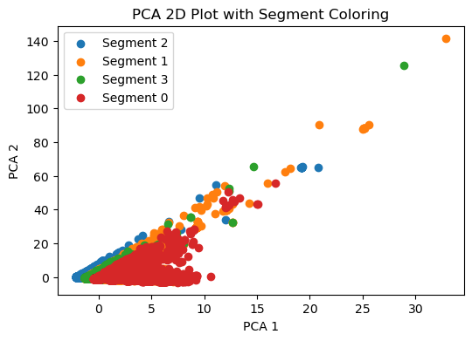
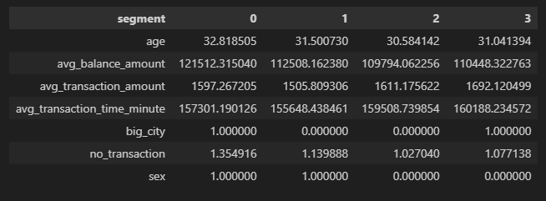
7. Appendix
Select number of cluster
The elbow method is a technique used in cluster analysis to determine the optimal number of clusters for a given dataset. The basic idea is to plot the within-cluster sum of squares (WCSS) against the number of clusters. WCSS is a measure of how spread out the data points within each cluster are, and it quantifies the compactness of the clusters.
K = 4 is chosen as the optimal number of clusters based on the elbow method because at that point in the plot, adding more clusters doesn't significantly reduce the within-cluster sum of squares.
BANK CUSTOMERS SEGMENTATION

Slide 18
7. Appendix
Reference
https://medium.com/grabngoinfo/4-clustering-model-algorithms-in-python-and-which-is-the-best-7f3431a6e624
https://grabngoinfo.com/k-means-clustering-example-code-using-python-scikit-learn/
https://grabngoinfo.com/5-ways-for-deciding-number-of-clusters-in-a-clustering-model/
BANK CUSTOMERS SEGMENTATION

Slide 19

8. About author
Peerapat Tancharoen holds a Bachelor's degree in Economics from Srinakharinwirot University, graduating with first honors and a GPA of 3.67. He also earned a Master's degree in Economics from Thammasat University, achieving a GPA of 3.98.
Contact me on
linkedin.com/in/peerapat-tancharoen-664759220/
peerapat.tcr@gmail.com
19
BANK CUSTOMERS SEGMENTATION

